Slide 1
Deployment and Security

Slide 2
Deploying Azure Resources
Infrastructure as Code
  ARMs and Biceps
  Terraform
GitHub Actions / DevOps Build Pipelines

Slide 3
Deployment is Easy Necessary
“Infrastructure as Code” – The ability to deploy all your services in the cloud from code rather than manually.
Important for:
  IT management of resources
  Geo-replication / Global availability and scale
  Security

Slide 4



Infrastructure as Code Options
ARM Templates
Bicep Language
Terraform
Pro: Azure can generate them.
Con: Difficult to read and edit.
Pro: From Microsoft. Easy to read.
Con: Lacking in examples and docs.
Pro: From HashiCorp. Multicloud.
Con: Proprietary and Pricey
Templates overview - Azure Resource Manager | Microsoft Docs
Bicep language for deploying Azure resources - Azure Resource Manager | Microsoft Docs
Docs overview | hashicorp/azurerm | Terraform Registry

Slide 5
IaC Language
Learning Curve
{
"$schema": "https://schema.management.azure.com/schemas/2019-04-01/deploymentTemplate.json#",
"contentVersion": "1.0.0.0",
"parameters": {
"location": {
"type": "string",
"defaultValue": "[resourceGroup().location]"
},
"storageAccountName": {
"type": "string",
"defaultValue": "[format(myStorage{0}', uniqueString(resourceGroup().id))]"
}
},
"resources": [
{
"type": "Microsoft.Storage/storageAccounts",
"apiVersion": "2021-06-01",
"name": "[parameters('storageAccountName')]",
"location": "[parameters('location')]",
"sku": {
"name": "Standard_LRS"
},
"kind": "StorageV2",
"properties": {
"accessTier": "Hot"
}
}
]
}
param location string = resourceGroup().location
param storageAccountName string = myStorage${uniqueString(resourceGroup().id)}'
resource storageAccount 'Microsoft.Storage/storageAccounts@2021-06-01' = {
name: storageAccountName
location: location
sku: {
name: 'Standard_LRS'
}
kind: 'StorageV2'
properties: {
accessTier: 'Hot'
}
}
BICEP
resource "azurerm_storage_account" "mystorage" {
name = "myStorage${random_integer.id.result}"
resource_group_name = azurerm_resource_group.rg.name
location = azurerm_resource_group.rg.location
account_tier = "Standard"
account_replication_type = "LRS"
tags = { environment = ”dev" }
}
TF (HCL)
ARM (JSON)

Slide 6
Deploying with GitHub Actions

Slide 7
Steps to Deploy with Terraform in GitHub Actions
Make GitHub Repo
Add YAML file to .github/actions folder
Add Terraform File(s) to Repo
Commit and Push Changes to Repo
Add Cloud Secrets to Repo

Slide 8
Security, Compliance, and Data Governance
Role-Based Access Controls
  Azure Active Directory
  Access Control Lists in Azure Storage
Compliance
  HIPAA, HITRUST, SOX, ISO
  Blueprints, etc.
Data Governance
  Azure Purview

Slide 9
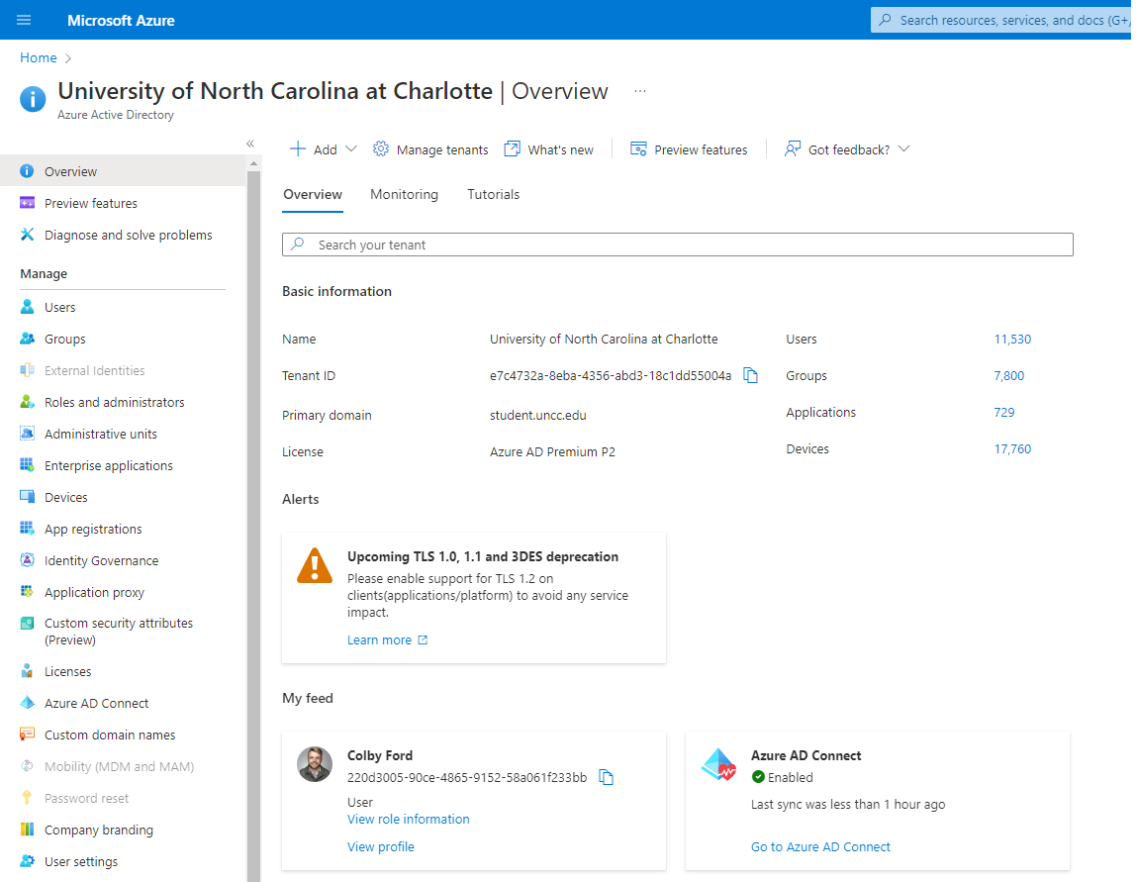

Azure Active Directory
Identity management for users and applications.
  Single Sign-On (SSO)
  App registrations
    External applications
    Service Principals and Managed Identities
  Role assignments
  Group organization

Slide 10
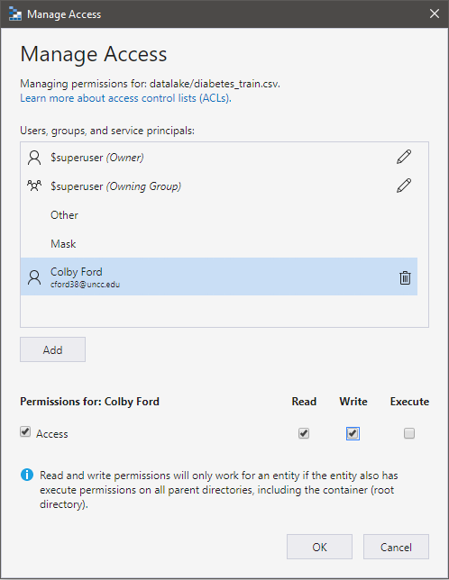

RBAC and
Access Control Lists
Common Role-Based Access Controls:
  Owner
    Grants full access to manage all resources, including the ability to assign roles in Azure RBAC.
  Contributor
    Grants full access to manage all resources, but does not allow you to assign roles in Azure RBAC
  Reader
    View all resources but does not allow you to make any changes.
RBAC: Broad Access to Resources
ACLs: Finer Access to Data

Slide 11
Compliance noun - com·​pli·​ance | \ kəm-ˈplī-ən(t)s \
“Conformity in fulfilling official requirements”

Slide 12
Global CIS benchmark CSA STAR Attestation CSA STAR Certification CSA STAR self-assessment SOC 1 SOC 2 SOC 3 ISO 20000-1 ISO 22301 ISO 27001 ISO 27017 ISO 27018 ISO 27701 ISO 9001 WCAG | US government CJIS CMMC CNSSI 1253 DFARS DoD IL2 DoD IL4 DoD IL5 DoD IL6 DoE 10 CFR Part 810 EAR FedRAMP FIPS 140 ICD 503 IRS 1075 ITAR JSIG NDAA NIST 800-161 NIST 800-171 NIST 800-53 NIST 800-63 NIST CSF Section 508 VPATs StateRAMP | Financial services 23 NYCRR Part 500 (US) AFM and DNB (Netherlands) AMF and ACPR (France) APRA (Australia) CFTC 1.31 (US) EBA (EU) FCA and PRA (UK) FFIEC (US) FINMA (Switzerland) FINRA 4511 (US) FISC (Japan) FSA (Denmark) GLBA (US) KNF (Poland) MAS and ABS (Singapore) NBB and FSMA (Belgium) OSFI (Canada) OSPAR (Singapore) PCI 3DS PCI DSS RBI and IRDAI (India) SEC 17a-4 (US) SEC Regulation SCI (US) SOX (US) TruSight | Automotive, education, energy, media, and telecommunication CDSA DPP (UK) FACT (UK) FERPA (US) MPA GSMA NERC (US) TISAX
 |  |  | Regional - Americas Argentina PDPA Canada privacy laws Canada Protected B US CCPA | Regional - EMEA EU Cloud CoC EU EN 301 549 ENISA IAF EU GDPR EU Model Clauses Germany C5 Germany IT-Grundschutz workbook Netherlands BIR 2012 Russia personal data law Spain ENS High Spain LOPD UAE DESC UK Cyber Essentials Plus UK G-Cloud UK PASF
Healthcare and life sciences ASIP HDS (France) EPCS (US) GxP (FDA 21 CFR Part 11) HIPAA (US) HITRUST MARS-E (US) NEN 7510 (Netherlands) |  |  | Regional - Asia Pacific Australia IRAP China GB 18030 China DJCP (MLPS) China TCS India MeitY Japan CS Gold Mark Japan ISMAP Japan My Number Act Korea K-ISMS New Zealand ISPC Singapore MTCS | Regional - EMEA EU Cloud CoC EU EN 301 549 ENISA IAF EU GDPR EU Model Clauses Germany C5 Germany IT-Grundschutz workbook Netherlands BIR 2012 Russia personal data law Spain ENS High Spain LOPD UAE DESC UK Cyber Essentials Plus UK G-Cloud UK PASF
Azure Compliance Offerings

Slide 13

HIPAA, HITECT, and HITRUST
Name
Telephone Number
Address
Dates (Smaller than years)
Fax Number
Email Address
Social Security Number
Medical Record Number
Health Plan Beneficiary Number
Account Numbers
License Number
Vehicle Identifiers
Device Identifiers and Serial Numbers
Web URLs
IP Addresses
Biometric Identifiers
Fingerprints, voice recording, etc.
Face Photos
Any other unique ID
HIPAA: Health Insurance Portability and Accountability Act of 1996
  Sets requirements for using, disclosing, and handling protected health information (PHI)
HITECH: Health Information Technology for Economic and Clinical Health Act of 2009
  Extends HIPAA for electronic health records and more modern, data-driven technology in healthcare
HITRUST: Health Information Trust Alliance
  A private company that sets standards, based on HIPAA/HITECH, and provides certification.
https://docs.microsoft.com/en-us/azure/compliance/offerings/offering-hipaa-us

Slide 14
SOX
Retain data for the req’d amount of time
Manage security and access controls
Know when something is deleted or changed (version control)
Physical and electronic access
Offsite backups
Prevent data tampering
Audit trails, logs
Prove you’ve retained compliance for a rolling 90 days
Visibility into system and org compliance
Sarbanes-Oxley Act of 2002
  US federal law from the Securities and Exchange Commission (SEC)
  Mandates financial record keeping practices
  Thanks to the ENRON and WorldCom scandals

Slide 15
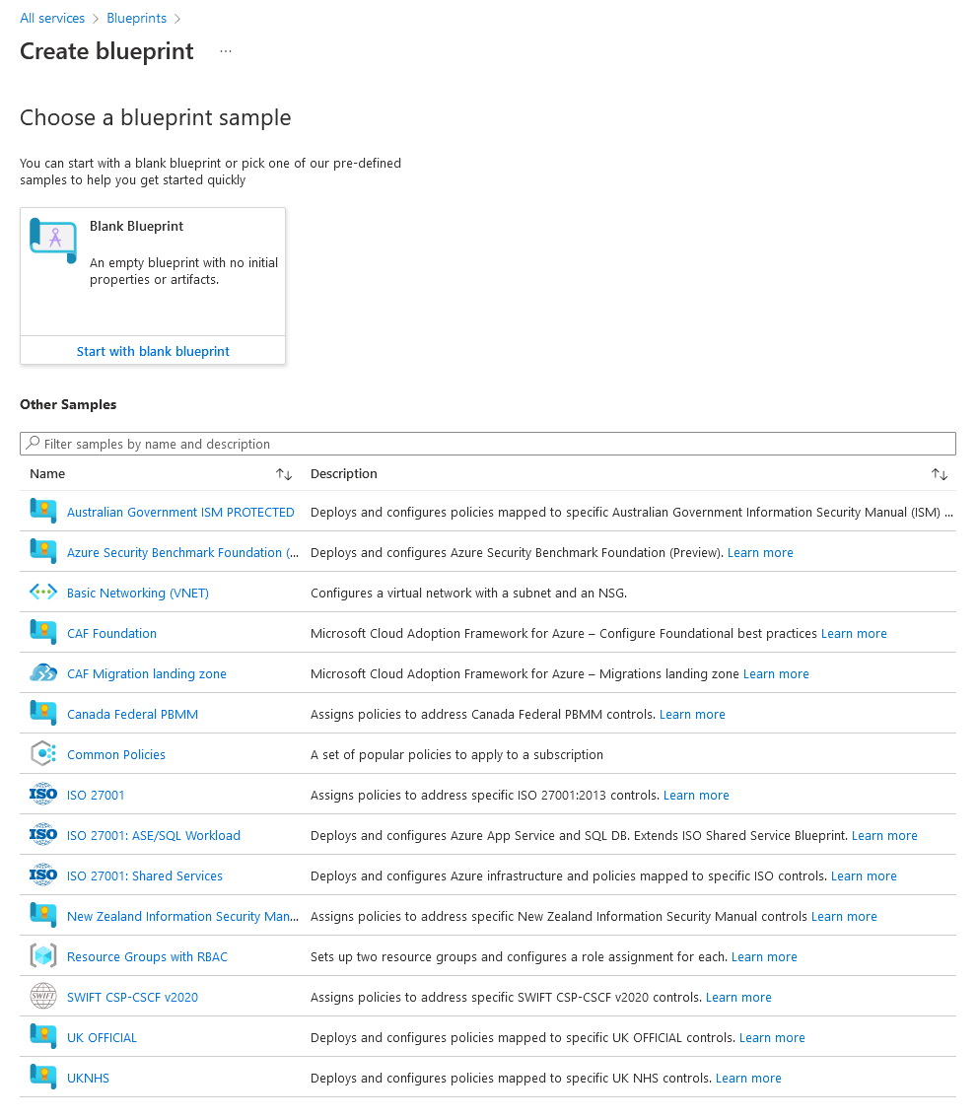

Azure Blueprints
Set of organizational standards and requirements for compliance or policy adherence.
Orchestrate the deployment of artifacts:
  Role Assignments
  Policy Assignments
  Azure Resource Manager templates (ARM templates)
  Resource Groups

Slide 16
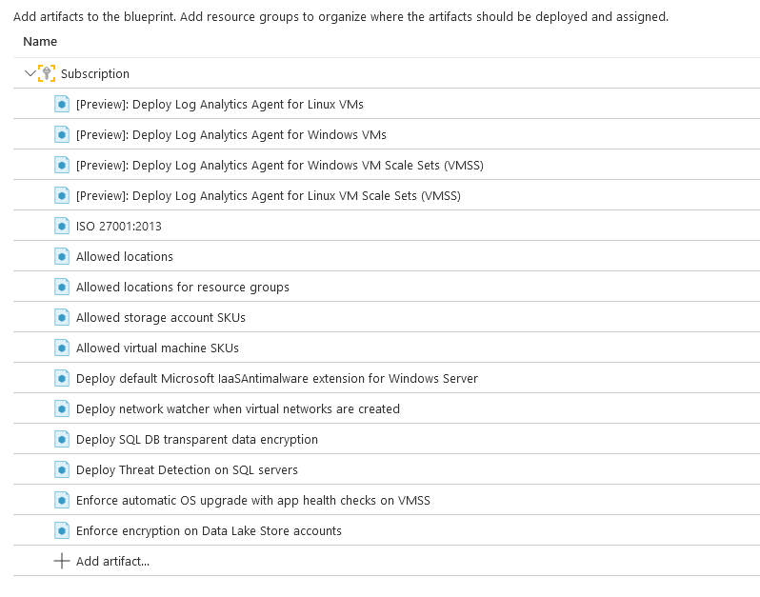

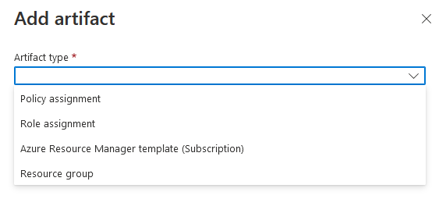
ISO 27001
International Standard for information security
14 main Controls
  Information security policies, HR security, asset management, access control, cryptography, physical security, etc.

